Slide 2
Unit 2: Introduction to C (6hrs)
History of C language
Features of C
The C as a middle-level language
The C as a system programming language
The C character set
Keywords and Identifiers
Data types
Constants, variables, and their declaration
Formatted input/output functions
The C Operators

Slide 3
History of C language
The C programming language was developed in the early 1970s by Dennis Ritchie at Bell Labs (AT&T) in the United States.
It was initially created to improve the UNIX operating system, which was originally written in assembly language.
Ritchie designed C as an evolution of the B language, which was itself derived from BCPL (Basic Combined Programming Language).
The goal was to create a language that would provide both high-level functionality and the low-level control required for system programming, which was essential for developing operating systems.

Slide 4
History of C language
C quickly gained popularity due to its versatility, efficiency, and portability, which made it ideal for both system-level and application-level programming.
In 1978, Brian Kernighan and Dennis Ritchie published "The C Programming Language," known as the "K&R" C, which became a widely accepted standard and led to C's rapid adoption.
Later, in 1989, the American National Standards Institute (ANSI) released a standardized version of C, known as ANSI C or C89, which further solidified its role as a foundational language in software development.

Slide 5
Features of C
Simple and Efficient: C is straightforward and provides a set of powerful functions that are easy to understand and use, resulting in efficient code.
Portability: C programs can run on various platforms with minimal or no modification, making C a highly portable language.
Structured Programming: C encourages modular programming by supporting structured code with functions and blocks, enabling better code organization and readability.
Rich Library: C includes a rich set of built-in functions, especially for input/output operations, which simplifies many programming tasks.

Slide 6
Features of C
Memory Management: C allows fine-grained control over memory with functions like malloc(), calloc(), free(), and pointer arithmetic, which is particularly useful in system-level programming.
Extensibility: C allows developers to add their own functions to the library.
Low-Level Access: C enables direct manipulation of hardware through pointers, structures, and bit manipulation, providing low-level access to memory and system resources.
Fast and Efficient: As a compiled language, C executes directly in machine code, making it fast and suitable for performance-critical applications.

Slide 7
C as a Middle-Level Language
C is considered a "middle-level" language because it combines features of both high-level and low-level programming languages:
High-Level Features: C has elements found in high-level languages, such as functions, libraries, and control structures which makes clear and modular code.
Low-Level Features: C also provides low-level capabilities, such as pointers, direct memory access, and bitwise manipulation, which works closely with the system hardware. This makes C particularly effective for developing operating systems, device drivers, and other performance-sensitive applications.

Slide 8
C as a Middle-Level Language
Being a middle-level language, C allows developers to write efficient and optimized code that can interact directly with hardware while maintaining an abstract layer that simplifies programming compared to pure assembly language.

Slide 9
C as a System Programming Language
C was originally created as a system programming language to write operating systems, most notably the UNIX OS.
Efficient Memory Management: C’s pointers and manual memory allocation functions help control memory usage directly for managing system resources.
Hardware Interaction: System programs need to communicate with hardware. C’s low-level capabilities, like pointer arithmetic and bitwise operations, allow it to perform tasks that require direct hardware access.

Slide 10
C as a System Programming Language
Performance: Since system programs must run efficiently, C’s compiled nature results in faster execution times compared to interpreted languages.
Portability: While C provides low-level functionality, it is still portable across platforms. This portability allows operating systems and system software written in C to be adapted easily to new hardware.
Modular and Structured Design: C’s structured approach allows for modularity, where complex system programs can be broken into manageable functions.

Slide 11
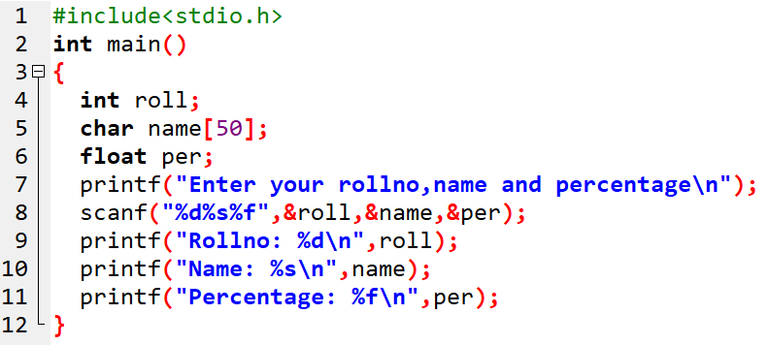
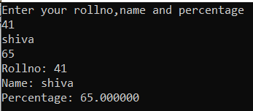
C Code

Slide 12
Comments
Used to put comments.
Also used to block the line of code which should not be executed.
Two types:
Single line comment
//variable declaration
//recursive function call
Multiline comment
/* This is a
Multi-line comment */

Slide 13
Character set
C has certain valid character sets.
A character denotes any letters, digits, or special symbols.
Understanding these characters is essential as they form the building blocks of C code.

Slide 14
Character set
Letters:
Uppercase: A, B, C, ..., Z
Lowercase: a, b, c, ..., z
C is case-sensitive, meaning that uppercase and lowercase letters are treated differently.
For example, sum and Sum would be considered different identifiers.

Slide 15
Character set
Digits:
0, 1, 2, ... , 9
Digits are used in numbers and as part of identifiers (though an identifier cannot start with a digit).

Slide 16
Character set
Special Characters:
Arithmetic Operators: +, -, *, /, %
Relational Operators: <, >, <=, >=, ==, !=
Logical Operators: &&, ||, !
Assignment Operator: =
Punctuation: , (comma), ; (semicolon), : (colon), . (dot)
Braces and Brackets: {}, [], ()
Other Symbols: &, |, ^, ~, ?, @, #, $, etc.

Slide 17
Character set
White Spaces:
Spaces, Tabs, and Newlines: These do not affect the program’s functionality but are used for readability and formatting.

Slide 18
C-Tokens
Token refers to smallest units of program which builds the entire program.
Six types of C-tokens.
Token
Keyword
Identifier
Constant
String
Operator
Punctuator

Slide 19
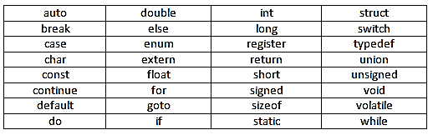
Keywords
In C, keywords are reserved words.
Have specific meanings and uses in the language syntax.
They cannot be used as identifiers (like variable names or function names)
32 Keywords

Slide 20
Keywords
Keyword | Description
auto | Declares automatic (local) variables.
break | Exits from a loop or switch statement.
case | Marks a block in a switch statement.
char | Declares a character variable.
const | Declares a constant variable.
continue | Skips the current iteration in a loop and proceeds to the next one.
default | Default case in a switch statement.
Keyword | Description
do | Begins a do...while loop.
double | Declares a double-precision floating-point variable.
else | Alternate branch of an if statement.
enum | Declares an enumeration (a set of named integer constants).
extern | Declares an external variable or function.
float | Declares a floating-point variable.
for | Begins a for loop.

Slide 21
Keywords
Keyword | Description
goto | Transfers control to a labeled statement.
if | Begins a conditional branch.
int | Declares an integer variable.
long | Declares a long integer variable.
register | Declares a register variable for faster access.
return | Returns a value from a function.
short | Declares a short integer variable.
signed | Declares a signed variable.
sizeof | Returns the size of a datatype or variable
Keyword | Description
static | Declares a static variable (persists across function calls).
struct | Declares a structure.
switch | Begins a switch selection statement.
typeof | Defines a new data type name.
union | Declares a union (a type that can hold different data types in the same memory location).
unsigned | Declares an unsigned variable..
void | Declares a function that returns no value or an empty pointer.

Slide 22
Keywords
Keyword | Description
volatile | Prevents the compiler from optimizing a variable’s value.
while | Begins a while loop
These keywords form the syntax of C and are essential for writing functional code.

Slide 23
Identifier
Identifiers are names used to identify variables, functions, arrays, structures, and other user-defined data in a C program.
They are created by the programmer and must follow specific rules.
Examples of Valid Identifiers:
sum, _count, totalValue, MAX_SIZE, calculateAverage
Examples of Invalid Identifiers:
2sum (begins with a digit)
float (keyword)
total-value (contains a hyphen

Slide 24
Rules for Identifier
Identifiers must begin with a letter (uppercase or lowercase) or an underscore _.
They cannot begin with a digit.
After the first character, identifiers can contain letters, digits, and underscores.
Identifiers are case-sensitive (total and Total are distinct identifiers).
Keywords cannot be used as identifiers.

Slide 25
Constant
Memory location that stores fixed value.
Constant value cannot be altered in the program.
Declared with const keyword
Syntax: const DataType identifier= value;
Eg: const float PI = 3.14;
Here, PI is a constant.
Also, can be defined using #define (is a preprocessor directive):
#define PI 3.14

Slide 26
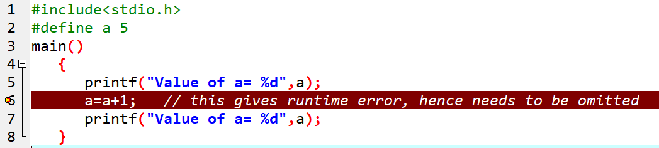
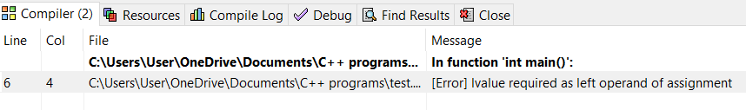
Constant

Slide 27
String
String is sequence of characters that are enclosed in double quotation marks (“ ”).
Eg: char greeting[ ]= “Hello, World!”;
Here “Hello, World!” is a string.
A character is a single letter or symbol, e.g., 'A', while a string is a series of characters enclosed in double quotes, e.g., "Hello".

Slide 28
Operator
Operators are various symbols that are used for the calculation of manipulation of data.
Eg: x = a + b;
Here = and + are operators. x, a, b are operands.
Operators are used on variables and values.

Slide 29
Punctuator
Punctuators are symbols used to separate elements in the code, organize the program, and mark the structure of the syntax.
Eg [], (), {}, ;, #, etc.

Slide 30
1. Common Punctuator
Semicolon (;):
Marks the end of a statement.
Example: int a = 5;
Comma (,):
Separates multiple variables or arguments in function calls.
Example: int a, b, c;
Colon (:):
Used in switch statements after each case.
Example: case 1: // code

Slide 31
2. Brackets and Braces:
Parentheses (()):
Used for function calls and grouping expressions.
Curly Braces ({}):
Define a block of code, such as in functions or loops.
Square Brackets ([]):
Define arrays.

Slide 32
Quotes:
Single Quotes ('): Enclose a single character constant.
Double Quotes ("): Enclose a string constant.
Asterisk (*):
Used for pointers, multiplication, or dereferencing a pointer.
Ampersand (&):
Used to get the address of a variable.
Hash (#):
Used for preprocessor directives, e.g., #include, #define.

Slide 33
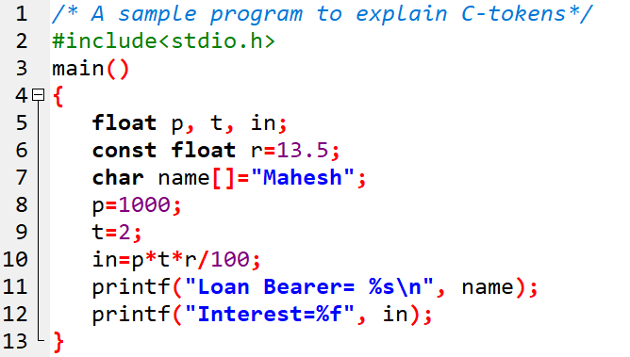
Sample Program
Keywords | float, const, return, char
Identifiers | p, t, in, name
Constants | r
Strings | Mahesh
Punctuators | [] () {} ; , “ ” \ %
Operators | = + *

Slide 34
End of Lecture 5

Slide 35
Data Types Variables and their declaration

